Slide 1

Batteries
Chapter
12
Topics Covered in Chapter 12
12-1: Introduction to Batteries
12-2: The Voltaic Cell
12-3: Common Types of Primary Cells
12-4: Lead-Acid Wet Cell
12-5: Additional Types of Secondary Cells
© 2007 The McGraw-Hill Companies, Inc. All rights reserved.

Slide 2
Topics Covered in Chapter 12
12-6: Series and Parallel Connected Cells
12-7: Current Drain Depends on Load Resistance
12-8: Internal Resistance of a Generator
12-9: Constant-Voltage and Constant-Current Sources
12-10: Matching a Load Resistance to the Generator r_{i}
McGraw-Hill
© 2007 The McGraw-Hill Companies, Inc. All rights reserved.

Slide 3
12-1: Introduction to Batteries
  Batteries consist of two or more voltaic cells that are connected in series to provide a steady dc voltage at the battery’s output terminals.
  The voltage is produced by a chemical reaction inside the cell. Electrodes are immersed in an electrolyte, which forces the electric charge to separate in the form of ions and free electrons.

Slide 4
12-2: The Voltaic Cell
(converts chemical energy into electric energy)
  A voltaic cell consists of two different metal electrodes that are immersed in an electrolyte (an acid or a base).
  The chemical reaction resulting from the immersion produces a separation of charges.
  The current capacity increases with large electrode sizes.
  The negative terminal is considered the anode of the cell because it forms positive ions in the electrolyte. The opposite terminal of the cell is its cathode.

Slide 5
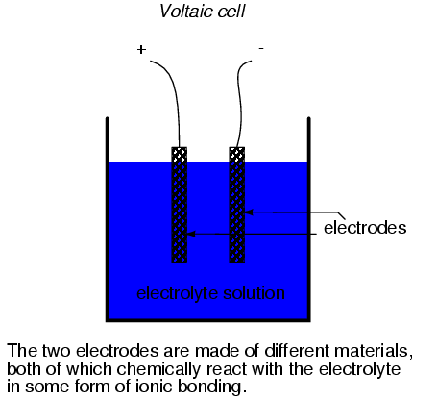
The Voltaic Cell
Motion of electrons in ionic bonding can be used to generate an electric current
A device constructed to do just this is called a voltaic cell, or cell for short

Slide 6
12-1: Introduction to Batteries
  A battery’s voltage output and current rating are determined by
    The elements used for the electrodes.
    The size of the electrodes.
    The type of electrolyte used.

Slide 7
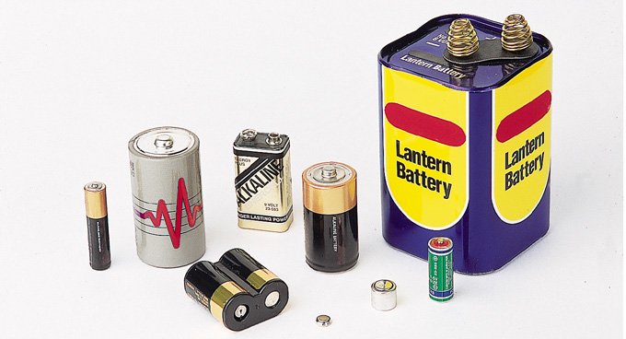
12-1: Introduction to Batteries
Cells and batteries are available in a wide variety of types.
Fig. 12-1: Typical dry cells and batteries. These primary types cannot be recharged.
Copyright © The McGraw-Hill Companies, Inc. Permission required for reproduction or display.

Slide 8
12-1: Introduction to Batteries
  Whether a battery may be recharged or not depends on the cells used to make up the battery.
  A primary cell cannot be recharged because the internal chemical reaction cannot be restored.
  A secondary cell, or storage cell, can be recharged because its chemical reaction is reversible.
  Dry cells have a moist electrolyte that cannot be spilled.
  Sealed rechargeable cells are secondary cells that contain a sealed electrolyte that cannot be refilled.

Slide 9
12-3: Common Types of Primary Cells
  There are several different types of primary cells in use today:
    Carbon-zinc dry cells.
    Alkaline cells.
    Zinc chloride cells.
    Mercury cells.
    Silver oxide cells.

Slide 10
12-3: Common Types of Primary Cells
Carbon-Zinc Dry Cell
  This is one of the most popular primary cells (often used for type AAA, AA, C, D).
  The negative electrode is made of zinc.
  The positive electrode is made of carbon.
  The output voltage of a single cell is about 1.5 V.
  Performance of the cell is better with intermittent operation.

Slide 11
12-3: Common Types of Primary Cells
Alkaline Cells
  The alkaline cell is another popular type also used for type AA, C, D, etc.
  It has the same 1.5V output as carbon-zinc cells, but they are longer-lasting.
  It consists of a zinc anode and manganese dioxide cathode in an alkaline electrolyte (potassium hydroxide).
  It works with high efficiency even with continuous use, due to low internal resistance.

Slide 12
12-3: Common Types of Primary Cells
Zinc Chloride Cells
  This cell is also referred to as a “heavy-duty” type battery.
  It is a modified zinc-carbon cell.
  It has little chance of liquid leakage because the cell consumes water along with the chemically active materials. The cell is usually dry at the end of its useful life.

Slide 13
12-3: Common Types of Primary Cells
Mercury Cells:
  This cell consists of a zinc anode, mercury compound cathode, and potassium or sodium hydroxide electrolyte.
  It is becoming obsolete due to the hazards associated with proper disposal of mercury.
Silver Oxide Cells:
  This cell consists of a zinc anode, silver oxide cathode, and potassium or sodium hydroxide electrolyte.
  It is typically available as 1.5V, miniature button form.
  Applications include hearing aids, cameras, and watches.

Slide 14
12-3: Common Types of Primary Cells
Lithium Cells:
  This cell offers high output voltage, long shelf life, low weight, and small volume.
  It comes in two forms of 3V output in widespread use:
    Lithium-sulfur dioxide (LiSO₂).
    Lithium-thionyl chloride.
  LiSO₂-type batteries contain methyl cyanide liquid solvent; if its container is punctured or cracked, it can release toxic vapors.
    Safe disposal of these cells is critical.

Slide 15
12-4: Lead-Acid Wet Cell
  This cell is a widely applied type of secondary cell, used extensively in vehicles and other applications requiring high values of load current.
  The positive electrode is made of lead peroxide.
  The negative electrode is made of spongy lead metal.
  The electrolyte is sulfuric acid.
  The output is about 2.1 volts per cell.
  Cells are typically used in series combinations of 3 (6-V battery) or 6 (12-V battery).

Slide 16
12-4: Lead-Acid Wet Cell
The secondary batteries used in vehicles have a reversible chemical process.
Discharge: The battery reacts by producing current flow in an external load circuit and produces lead sulfate and water.
D
Pb + PbO₂ + 2H₂SO₄ 2PbSO₄ + 2H₂O
C
Charge: The battery reacts to a reverse current from
an external energy source and produces lead, lead
peroxide, and sulfuric acid.

Slide 17
12-4: Lead-Acid Wet Cell
Current Ratings
  Lead-acid batteries are rated in terms of how much discharge current they can supply for a specified amount of time.
  The A•h unit is amperes-hours. Generally, this rating is proportional to the physical size.

Slide 18
12-4: Lead-Acid Wet Cell
  An automobile battery might have a 200 A•h rating. How long can this battery supply 20 amperes?
  The actual ampere-hours delivered varies with battery age and condition, temperature and discharge rate.
Capacity
200 A•h
Time =
=
= 10 hours
Load current
20 A

Slide 19
12-4: Lead-Acid Wet Cell
Specific Gravity
  Specific gravity is a ratio that compares the weight of a substance with the weight of water.
  The states of discharge (how much charge the battery has left) is checked by measuring the specific gravity of the electrolyte.

Slide 20
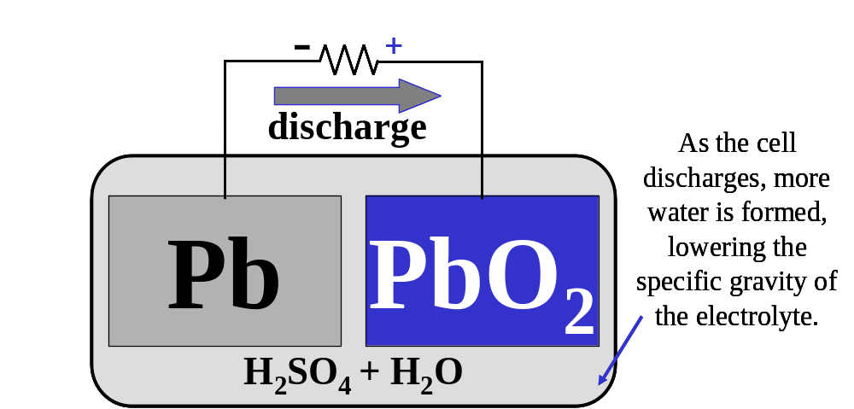
12-4: Lead-Acid Wet Cell
One cell of an automobile battery.
Pb + PbO₂ + 2H₂SO₄ 2PbSO₄ + 2H₂O

Slide 21
12-4: Lead-Acid Wet Cell
Charging Lead-Acid Batteries
  Apply about 2.5 V per cell.
  Attach the terminal of a battery charger directly to the corresponding terminals of the battery.
    Positive terminal to positive terminal.
    Negative terminal to negative terminal.
  This process restores the battery’s ability to deliver current and voltage to a load.

Slide 22
12-4: Lead-Acid Wet Cell
Charging an Automobile Battery (one cell shown).
Charger produces 2.5 V (about 15 V for a 12 V battery)
charge
As the cell
As the cell
As the cell
discharges, more
discharges, more
discharges, more
water is formed,
water is formed,
water is formed,
Pb
Pb
Pb
PbO
PbO
PbO
lowering the
lowering the
lowering the
specific gravity of
specific gravity of
2
specific gravity of
2
2
the electrolyte.
the electrolyte.
the electrolyte.
H
H
H
SO
SO
SO
+ H
+ H
+ H
O
O
O
2
2
2
4
4
4
2
2
2
Pb + PbO₂ + 2H₂SO₄ 2PbSO₄ + 2H₂O

Slide 23
12-5: Additional Types of Secondary Cells
Nickel Cadmium (NiCd) Cells and Batteries
  This type of cell delivers high current.
  It can be recharged many times.
  It can be stored for long periods of time.
  Applications include
    Portable power tools.
    Alarm systems.
    Portable radio and TV equipment.

Slide 24
12-5: Additional Types of Secondary Cells
Nickel Cadmium (NiCd) Cells and Batteries
  The electrolyte is potassium hydroxide (KOH) but does not appear above, as its function is to act as a conductor for the transfer of the hydroxyl (OH) ions.
  Its specific gravity does not change with the state of charge.
D
2 Ni(OH)
+
Cd
2 Ni(OH)
+
Cd
(OH)
3
2
2
C

Slide 25
12-5: Additional Types of Secondary Cells
Nickel-Metal-Hydride (NiMH) Cells
  These cells are used in applications demanding long-running battery performance (e.g., high-end portable electrical or electronic products like power tools).
  They offer 40% more capacity over a comparably-sized NiCd cell.
  They contain the same components as a NiCd cell, except for the negative electrode.
  They are more expensive than NiCd cells, self-discharge more rapidly, and cannot be cycled as frequently as NiCd cells.

Slide 26
12-5: Additional Types of Secondary Cells
Nickel-Iron (Edison) Cells
  These cells were once used in industrial truck and railway applications.
  They are now almost obsolete due to lead-acid batteries.
Nickel-Zinc Cells
  These cells were previously used in some railway applications.
  Their high energy density created interest in their application to electric cars.
  They have limited life cycles for charging.

Slide 27
12-5: Additional Types of Secondary Cells
Fuel Cells
  A fuel cell is an electrochemical device that converts chemicals (such as hydrogen and oxygen) into water and produces electricity in the process.
  As long as the reactants (H and O) are supplied to the fuel cell, it will continually produce electricity and never go dead, unlike conventional batteries.

Slide 28
12-5: Additional Types of Secondary Cells
Fuel Cells
  Fuel cells using methanol and oxygen are being developed.
  Fuel cells are used extensively in the space program as sources of dc power.
  They are very efficient; capable of providing hundreds of kilowatts of power.

Slide 29
12-5: Additional Types of Secondary Cells
Solar Cells
  Solar cells convert the sun’s light energy into electric energy.
  They are made of semiconductor materials.
  They are arranged in modules that are assembled into a large solar array to produce the required power.

Slide 30
12-6: Series and Parallel
Connected Cells
An applied voltage higher than the voltage of one cell can be obtained by connecting cells in series.
The total voltage available across the battery of cells is equal to the sum of the individual values for each cell.
Parallel cells have the same voltage as one cell but have more current capacity.
To provide a higher output voltage and more current capacity, cells can be connected in series-parallel combinations.
The combination of cells is called a battery.

Slide 31
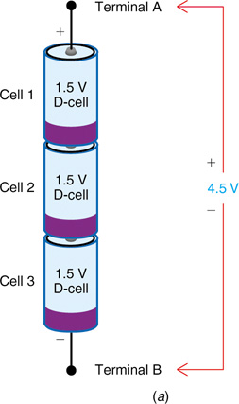
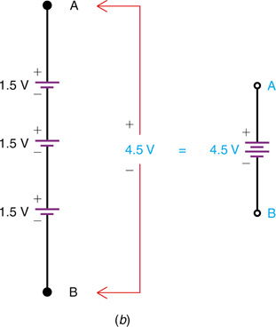
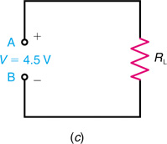
12-6: Series and Parallel
Connected Cells
The current capacity of a battery with cells in series is the same as that for one cell because the same current flows through all series cells.
Fig. 12-14: Cells connected in series for higher voltage. Current rating is the same as for one cell. (a) Wiring. (b) Schematic symbol for battery with three series cells. (c) Battery connected to lead resistance R_{L}.
Copyright © The McGraw-Hill Companies, Inc. Permission required for reproduction or display.

Slide 32
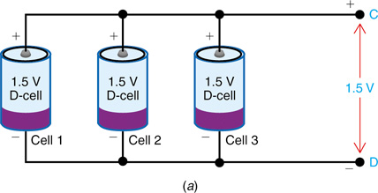
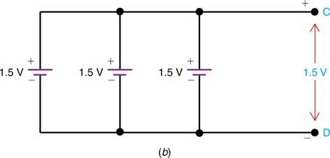
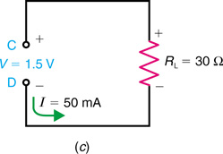
12-6: Series and Parallel
Connected Cells
The parallel connection is equivalent to increasing the size of the electrodes and electrolyte, which increases the current capacity.
Fig. 12-15: Cells connected in parallel for higher current rating. (a) Wiring. (b) Schematic symbol for battery with three parallel cells. (c) Battery connected to lead resistance R_{L}.
Copyright © The McGraw-Hill Companies, Inc. Permission required for reproduction or display.

Slide 33
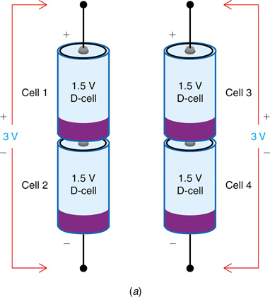
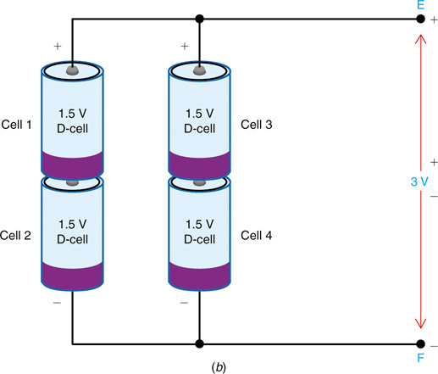
12-6: Series and Parallel
Connected Cells
To provide a higher output voltage and more current capacity, cells can be connected in series-parallel combination.
Fig. 12-16: Cells connected in series-parallel combinations. (a) Wiring two 3-V strings, each with two 1.5-V cells in series. (b) Wiring two 3-v strings in parallel.
Copyright © The McGraw-Hill Companies, Inc. Permission required for reproduction or display.

Slide 34
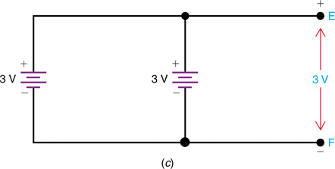
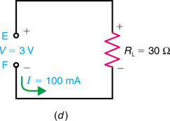
12-6: Series and Parallel
Connected Cells
Fig. 12-16 cont. (c) Schematic symbol for the battery in (b) with output of 3 V. (d) Equivalent battery connected to lead resistance RL.
Copyright © The McGraw-Hill Companies, Inc. Permission required for reproduction or display.

Slide 35
12-7: Current Drain Depends on Load Resistance
It is important to note the current rating of batteries, or any voltage source, is only a guide to typical values permissible for normal service life.
The actual amount of current produced when the battery is connected to a load resistance is equal to:
I = V/R by Ohm’s law.

Slide 36
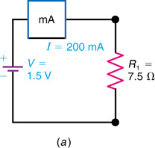
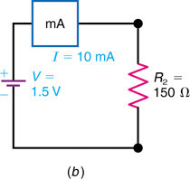
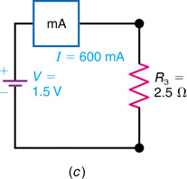
12-7: Current Drain Depends on Load Resistance
I = V/R₁ = 200 mA
I = V/R₂ = 10 mA
I = V/R₃ = 600 mA
A cell delivers less current with higher resistance in the load circuit.
A cell can deliver a smaller load current for a longer time.
Fig. 12-17: An example of how current drain from a battery used as a voltage source depends on R of the load resistance. Different values of I are shown for the same V of 1.5 V. (a) The V/R₁ equals I of 200 mA. (b) The V/R₂ equals I of 10 mA. (c) The V/R₃ equals I of 600 mA.
Copyright © The McGraw-Hill Companies, Inc. Permission required for reproduction or display.

Slide 37
12-8: Internal Resistance of a Generator
  A generator is any source that produces continuous voltage output.
  Internal resistance (r_{i}) causes the output voltage of a generator to drop as the amount of current increases. All generators have internal resistance.
  Matching the load resistance to the internal resistance of the generator causes the maximum power transfer from the generator to the load.

Slide 38
12-8: Internal Resistance of a Generator
Measuring r_{i}
r_{i}
V_{NL} – V_{L}
r_{i} =
0.01 Ω
I_{L}
12 V
V_{NL} = 12
V_{L} = 11.9
12 – 11.9
=
10 A
10
= 0.01 Ω

Slide 39
Problem
Calculate internal resistance of a generator if the output voltage drops from 50 V with zero load current to 45 V with 4 A of load current.
Notes:
internal resistance = 1.25 ohm

Slide 40
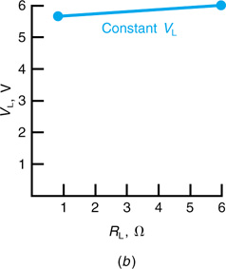
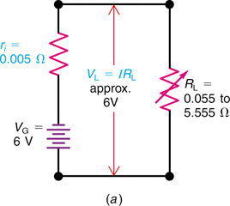
12-9: Constant-Voltage Source
Constant-Voltage Generator
  A constant-voltage generator has a very low internal resistance. It delivers a relatively constant output voltage in spite of changes in the amount of loading.
Fig. 12-21: Constant-voltage generator with low r_{i}. The V_{L} stays approximately the same 6 V as I varies with R_{L}. (a) Circuit. (b) Graph for V_{L}.
Copyright © The McGraw-Hill Companies, Inc. Permission required for reproduction or display.

Slide 41
12-10: Matching a Load Resistance to the Generator r_{i}
  The power curve peaks where R_{L} = r_{i}. At this point, the generator transfers maximum power to the load.
  As R_{L} increases, V_{L} increases, I decreases, efficiency increases (less power lost in r_{i}).
  As R_{L} decreases, V_{L} decreases, I increases.
  When r_{i} = R_{L}, maximum power yields 50% efficiency.
  To achieve maximum voltage rather than power, R_{L} should be as high as possible.

Slide 42
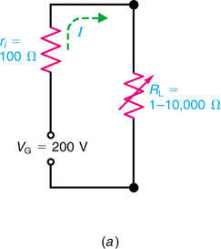
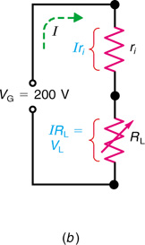
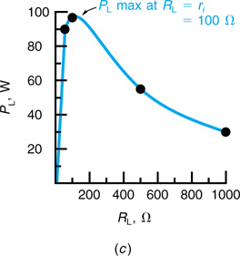
12-10: Matching a Load Resistance to the Generator r_{i}
R_{i} = 100 Ω
R_{L}: variable from
1 to 10, 000 Ω
r_{i} = R_{L} = 100 Ω
I = 200/200
I = 1 A
NOTE: P_{L} is maximum when R_{L} = r_{i} = 100 Ω
Fig. 12-24: Circuit for varying R_{L} to match r_{i}. (a) Schematic diagram. (b) Equivalent voltage divider for voltage output across R_{L}. (c) Graph of power output P_{L} for different values of R_{L}.
Copyright © The McGraw-Hill Companies, Inc. Permission required for reproduction or display.

